Slide 1
LIVER DISEASE CLASSIFICATION
P-331

Slide 2

Group-2
Group 2
Mr. Clive Dominic Andrews
Mr. Yash Kalose
Mr. Pranav Bandu Ranpise
Mr. Babasaheb Anil Gade
Mr. Amresh Kumar
Ms. Sneha Tulasigeri
Mr. Sharath S
Ms. MANASA N

Slide 3
Introduction
Business Objective
Liver diseases are a diverse group of medical conditions that affect the liver, a vital organ responsible for various functions in the body, including metabolism, detoxification, and nutrient storage..
Understanding the classification of liver diseases is crucial for accurate diagnosis, appropriate treatment, and effective management to improve patient outcomes. It also helps healthcare professionals tailor interventions based on the specific underlying causes and manifestations of each condition
The business objectives related to liver disease are typically associated with organizations operating in the healthcare industry, including pharmaceutical companies, medical device manufacturers, healthcare providers, and research institutions.
These objectives aim to address various aspects of liver disease prevention, diagnosis, treatment, and patient care.

Slide 4
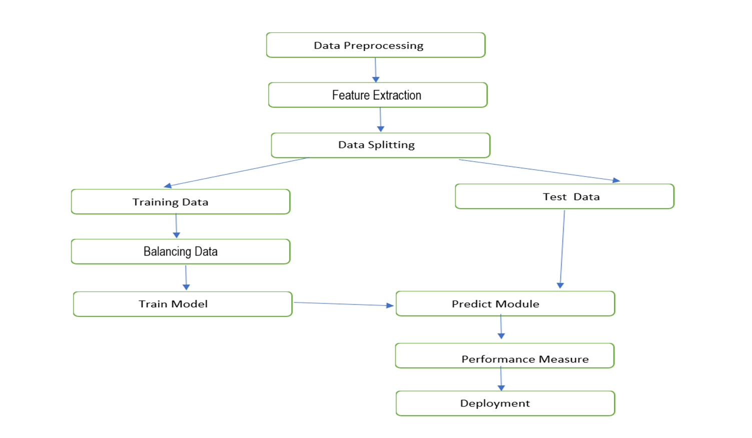
Project Work Flow

Slide 5
Data Collection and Preprocessing
Exploratory Data Analysis
We collected data from different hospitals and captured all the details related to Liver disease and categorized them in different groups.
Before training our model, we need to preprocess and prepare the Liver Disease data through EDA and various transformation for better prediction of the type of Liver Disease.
Exploratory data analysis (EDA) is used by data scientists to analyze and investigate data sets and summarize their main characteristics, often employing data visualization methods.
EDA is primarily used to see what data can reveal beyond the formal modeling or hypothesis testing task and provides a better understanding of data set variables and the relationships between them.

Slide 6
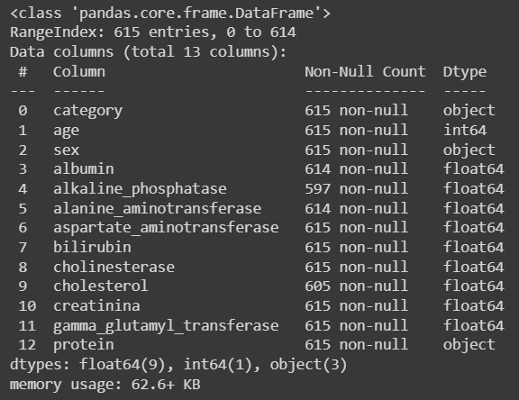
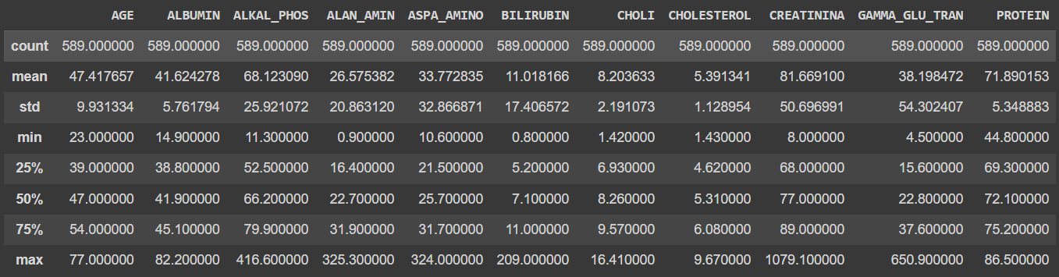
Data is checked , and there is no null value present in the dataset . Also, we got to know the datatype of the columns .
We performed all the statistics , we got to know the main values of mean, standard deviation , min-max.

Slide 7
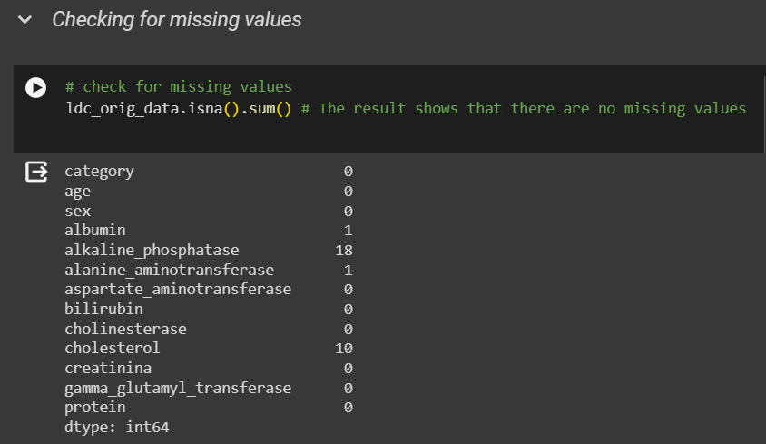
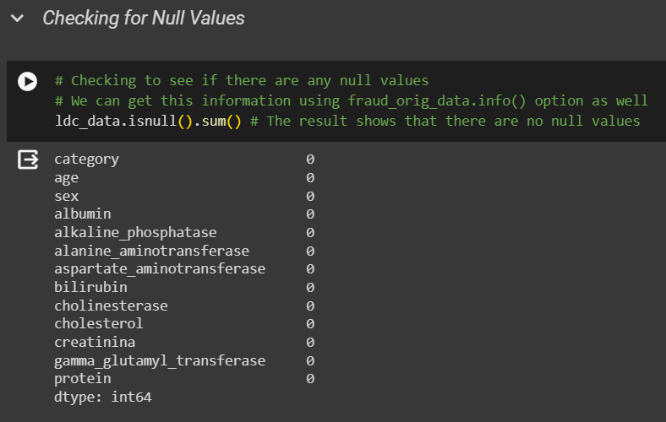

Slide 8
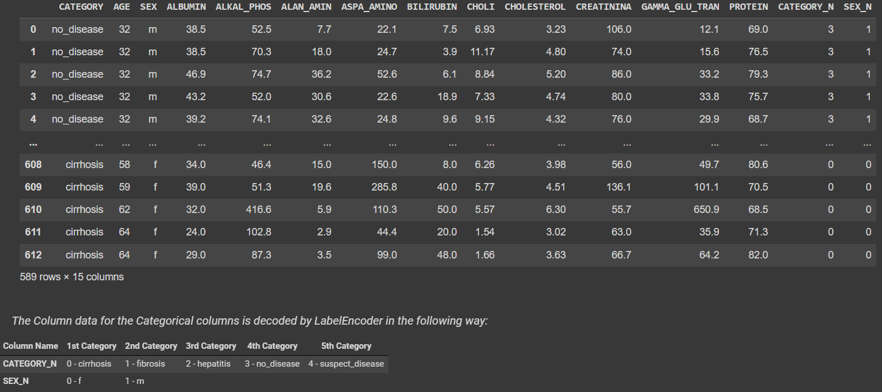
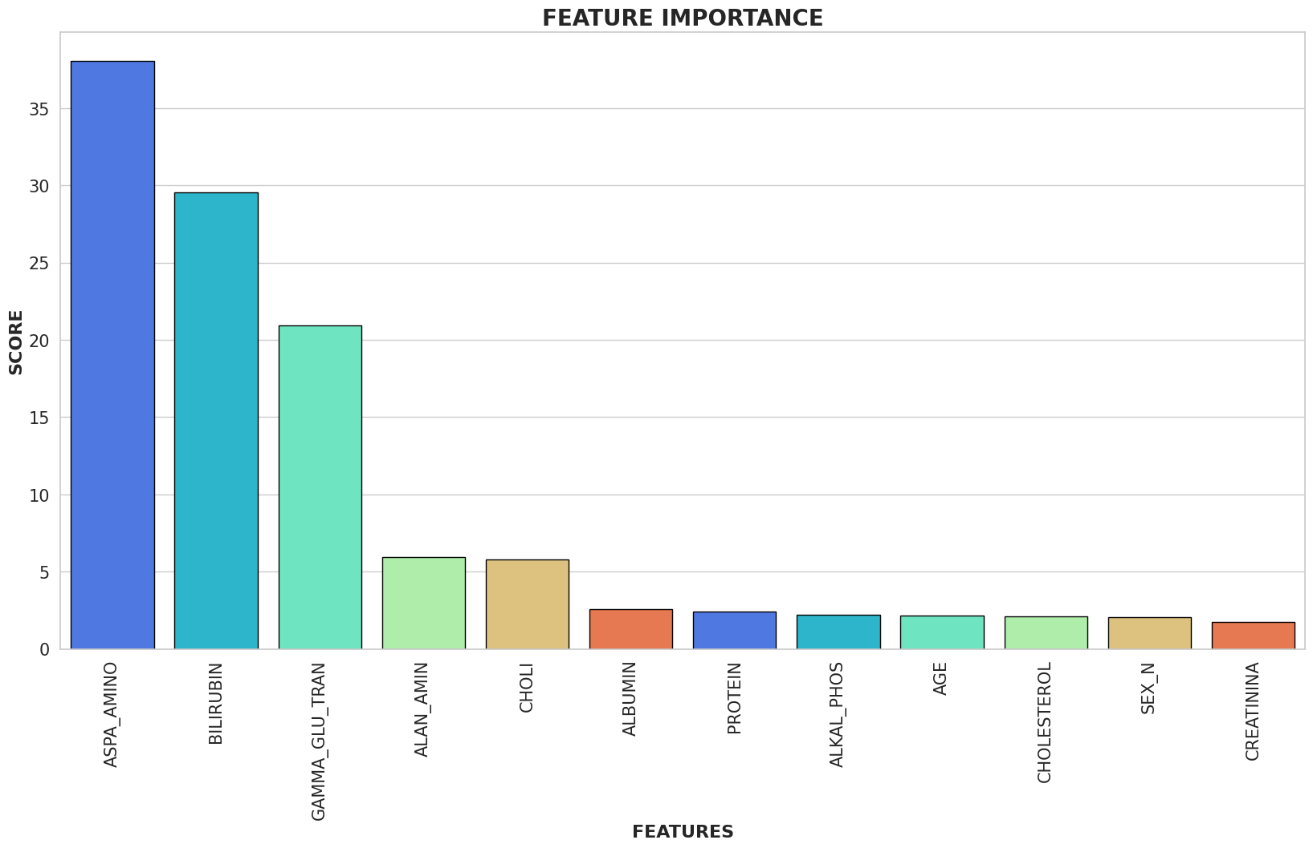
Label Encoding The Category and Sex Columns
Feature Score of All Columns

Slide 9
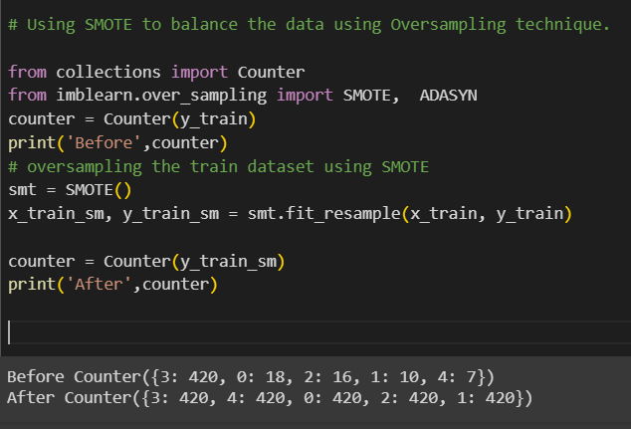
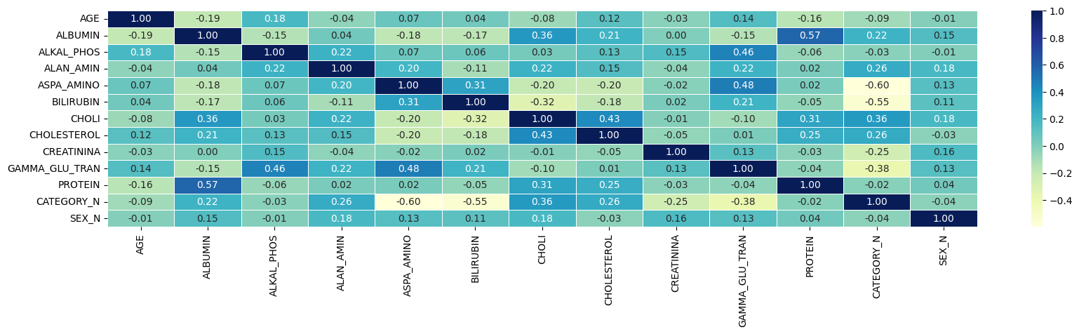
Balancing the Category Column
Correlation Heat Map

Slide 10
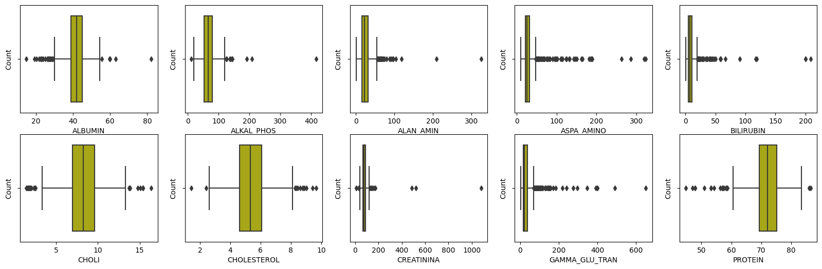
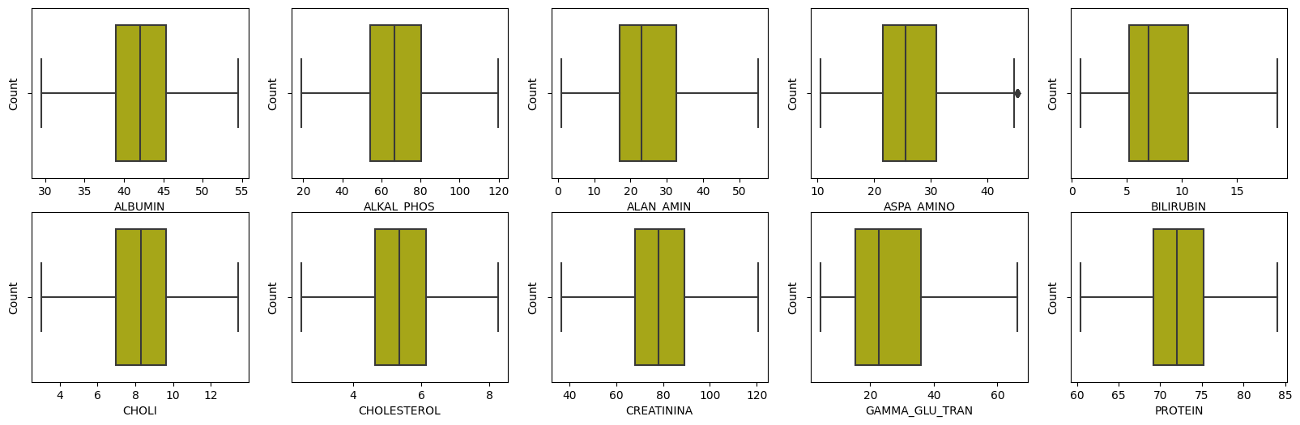
Before Outlier Treatment
After Outlier Treatment

Slide 11
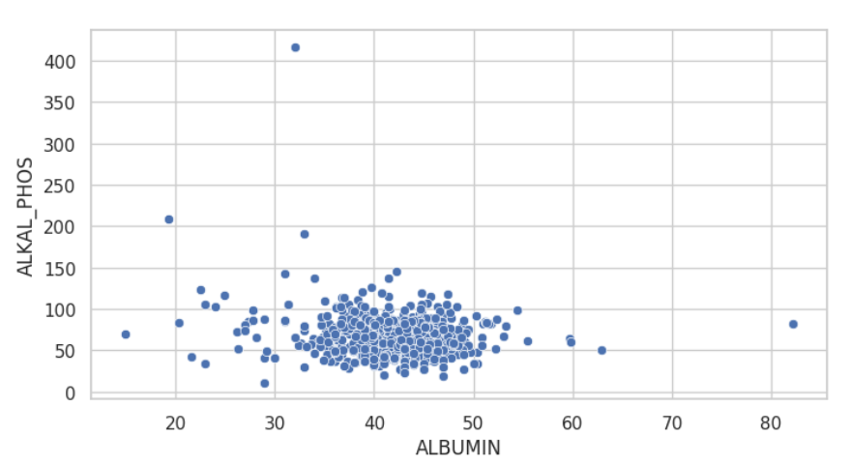
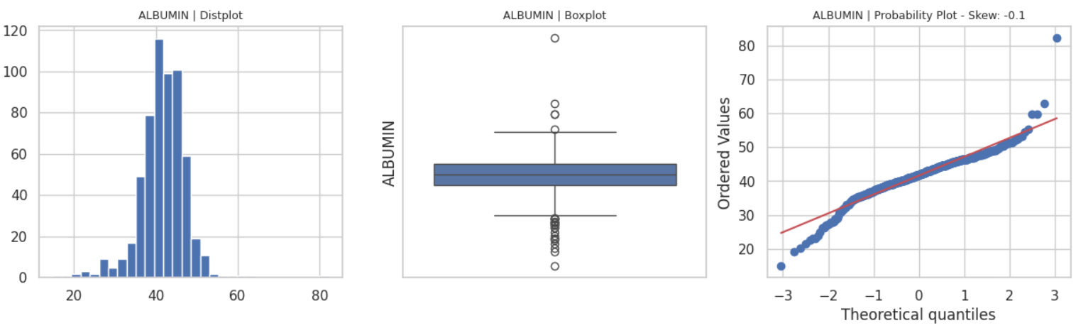
Visualization
Scatter Plot
Bar, box and Line Plots

Slide 12
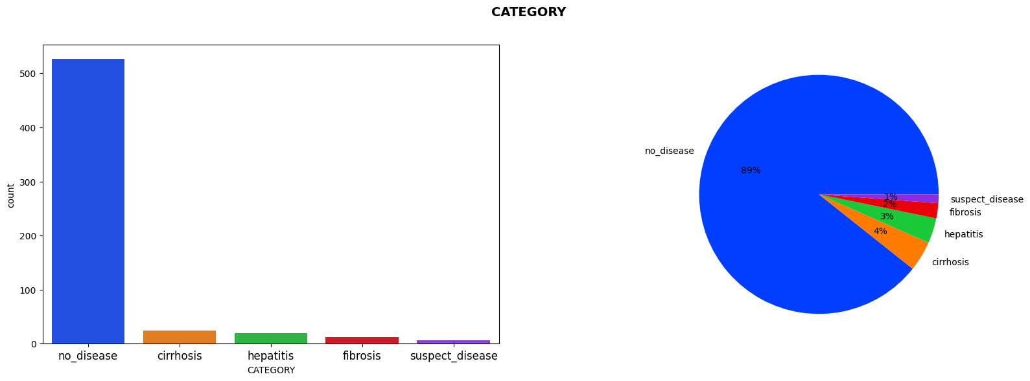
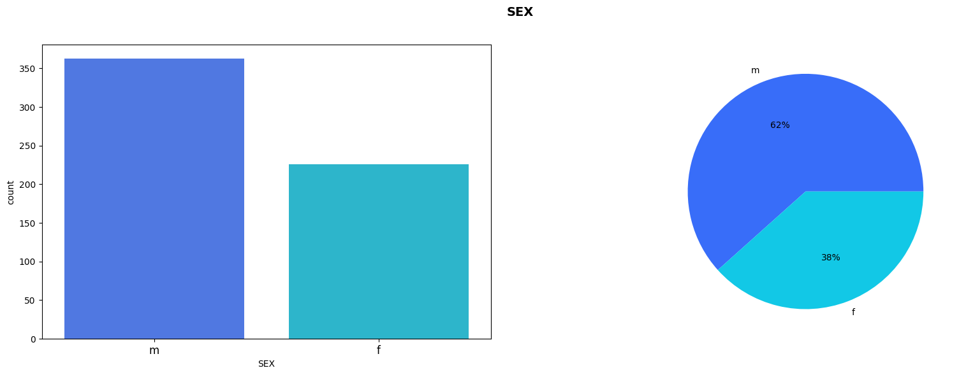
Bar And Pie Plot For Disease
Bar And Pie Plot For Sex

Slide 13
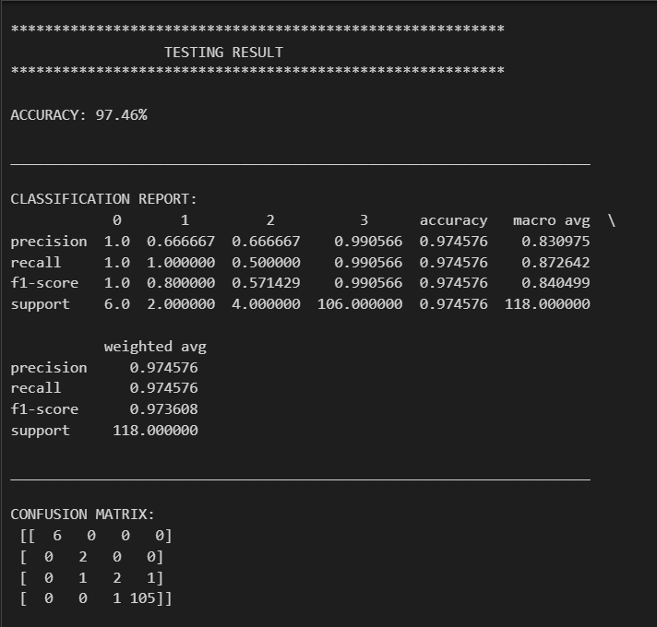
Model Creation
Accuracy, Confusion Matrix and Classification Report for RF_XGB Model

Slide 14
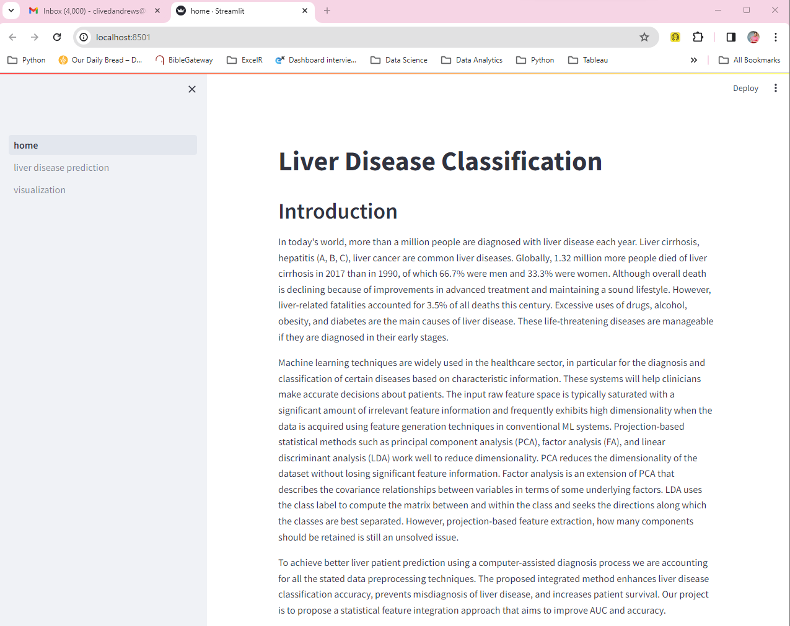
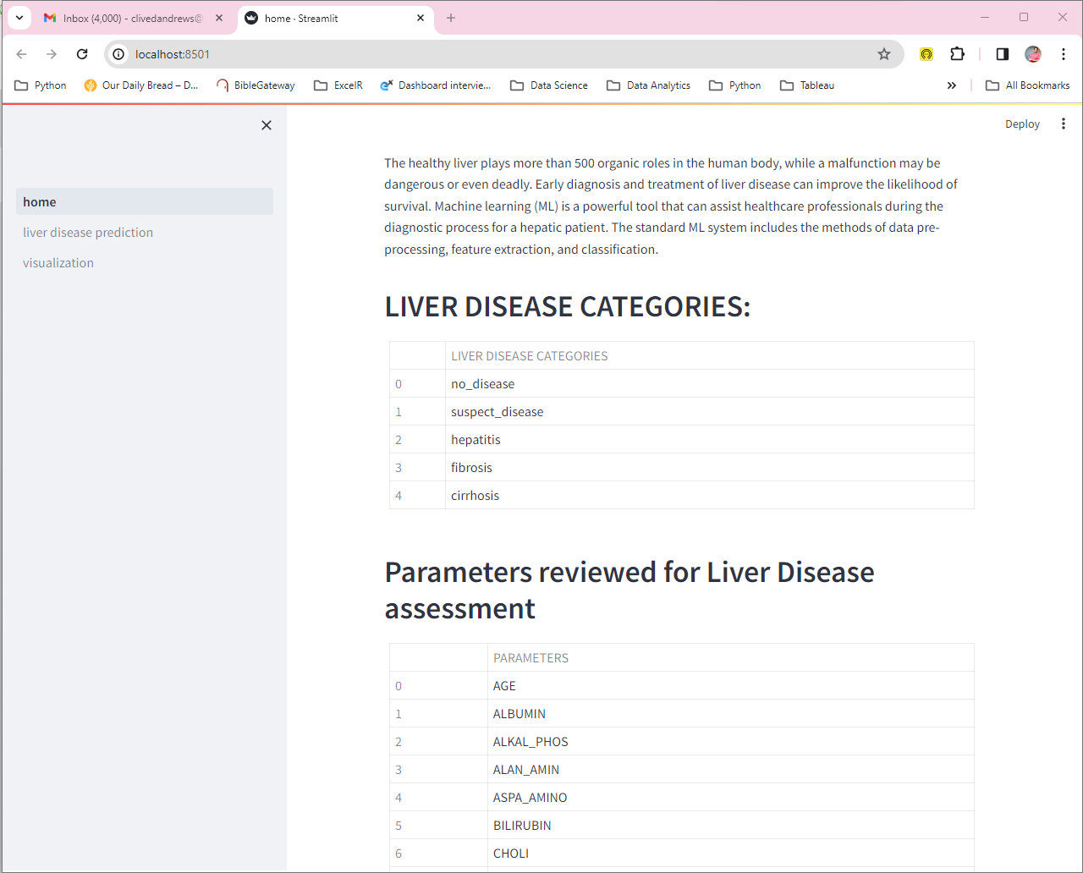
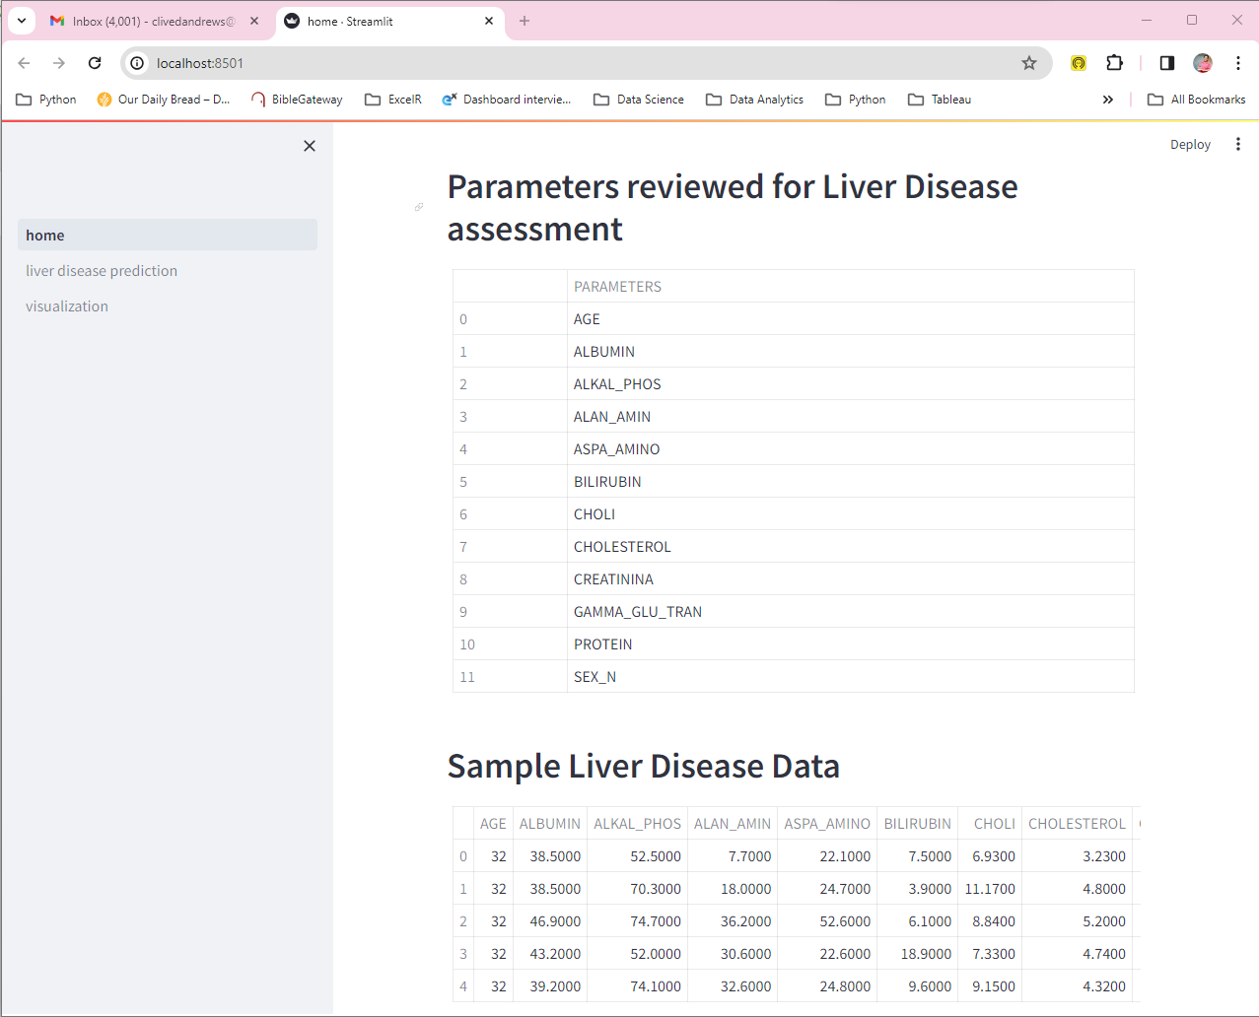
Model Deployment
Home Page

Slide 15
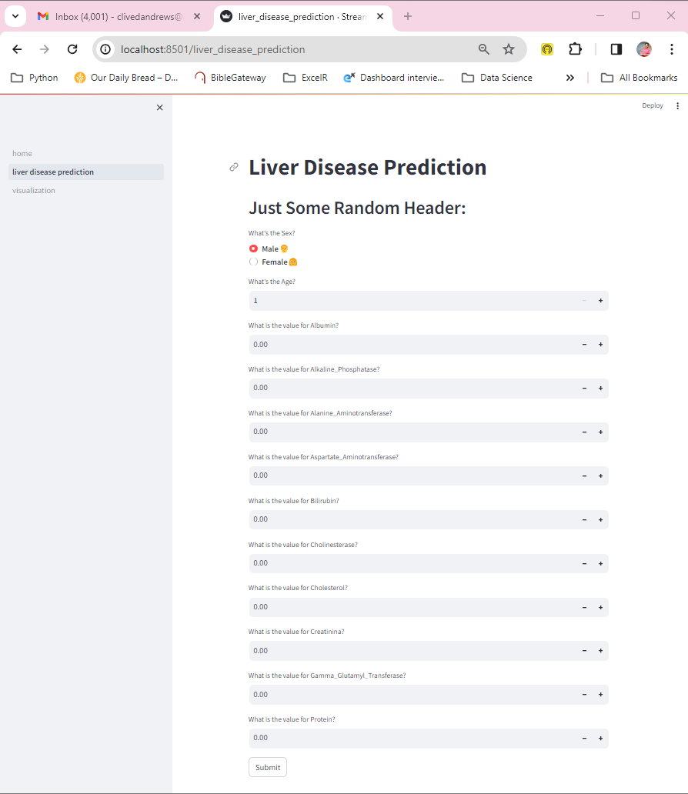
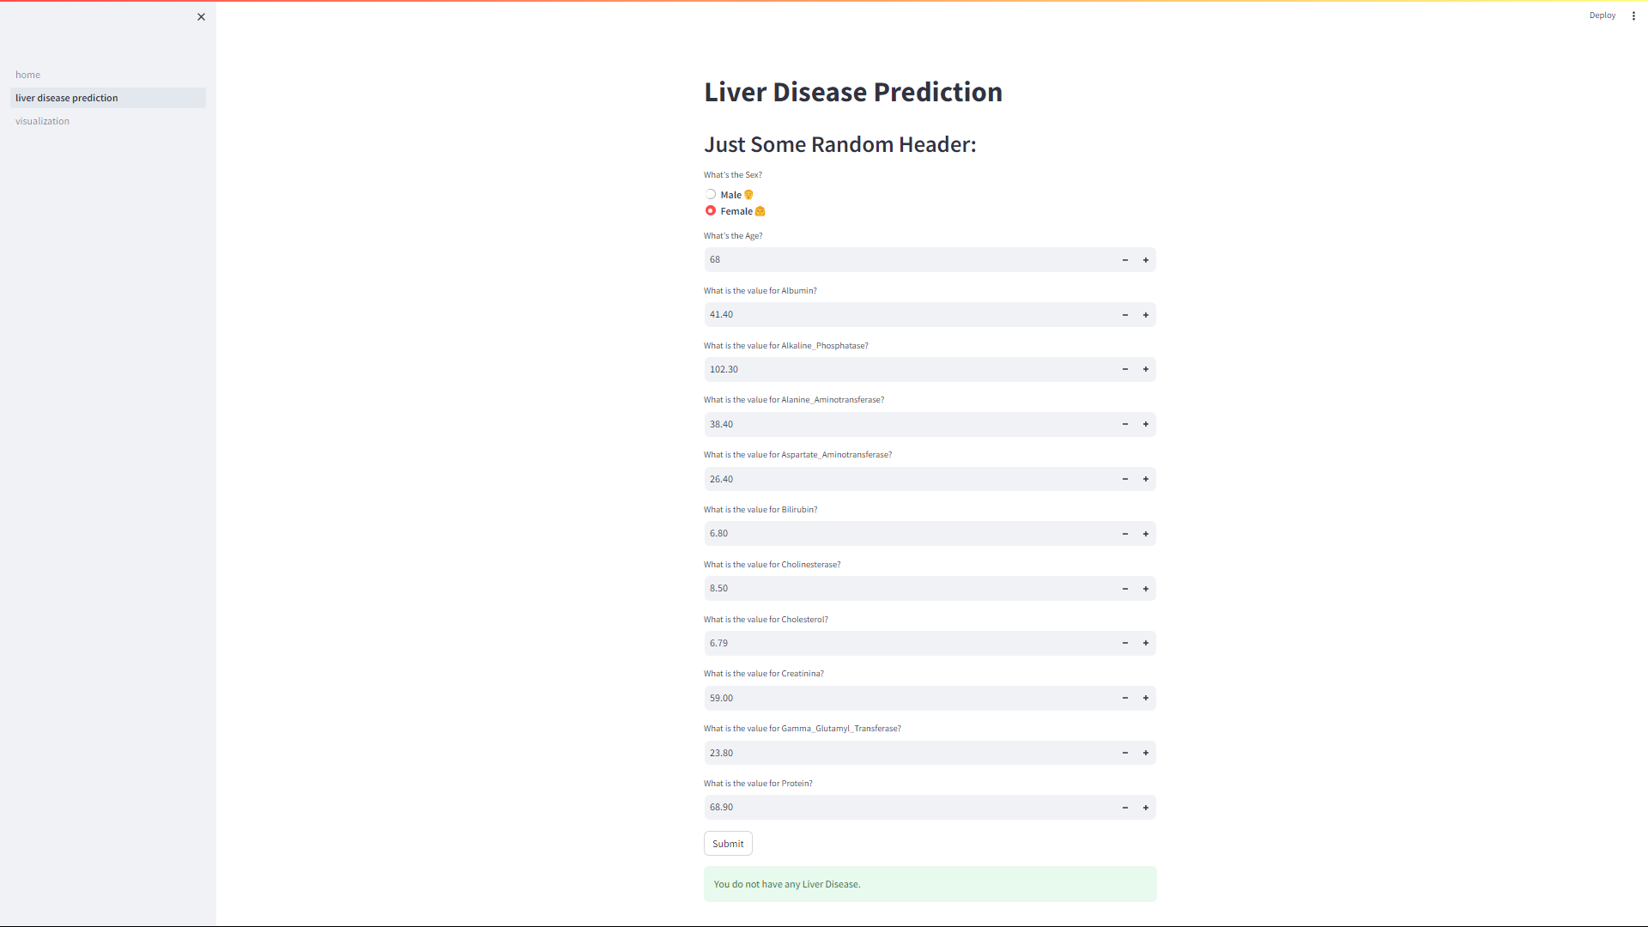
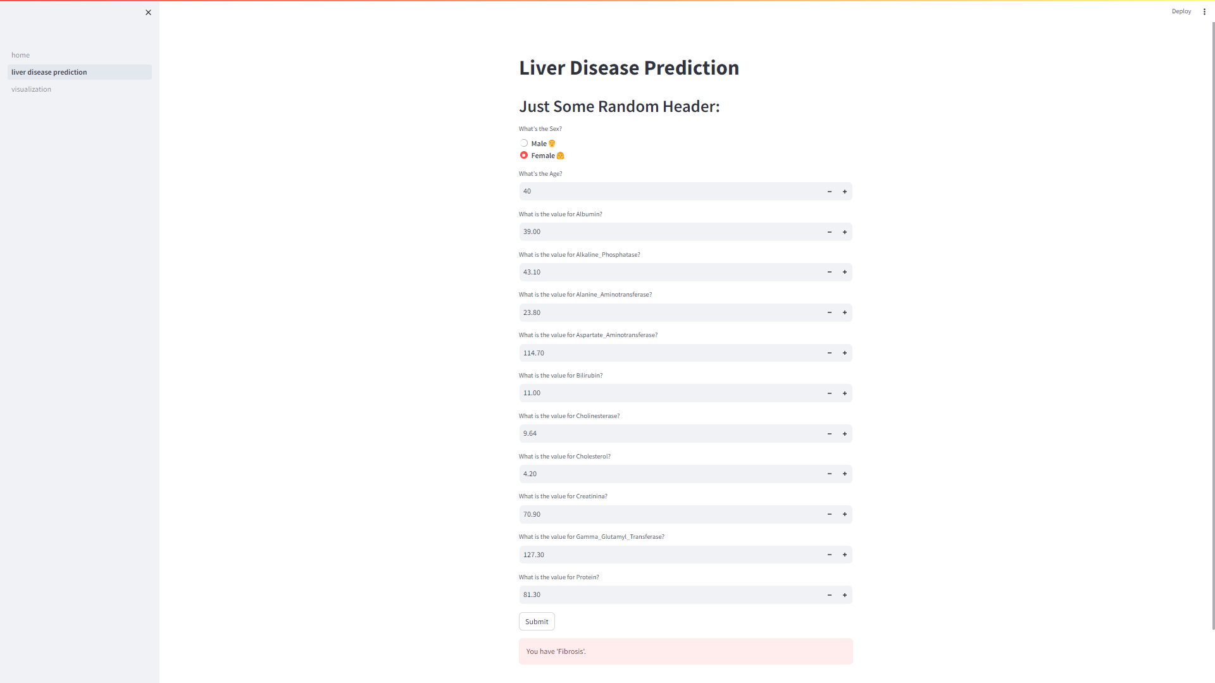
Liver Disease Prediction

Slide 16
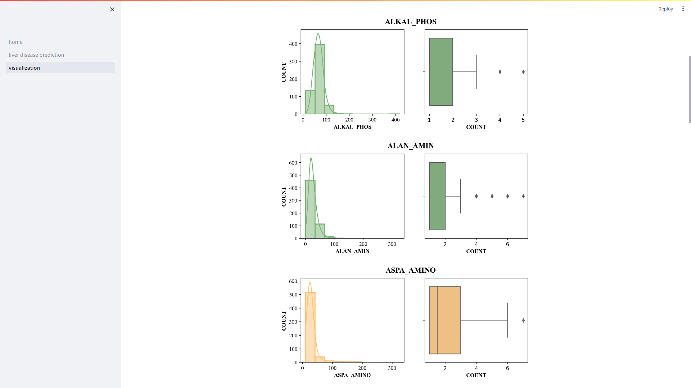
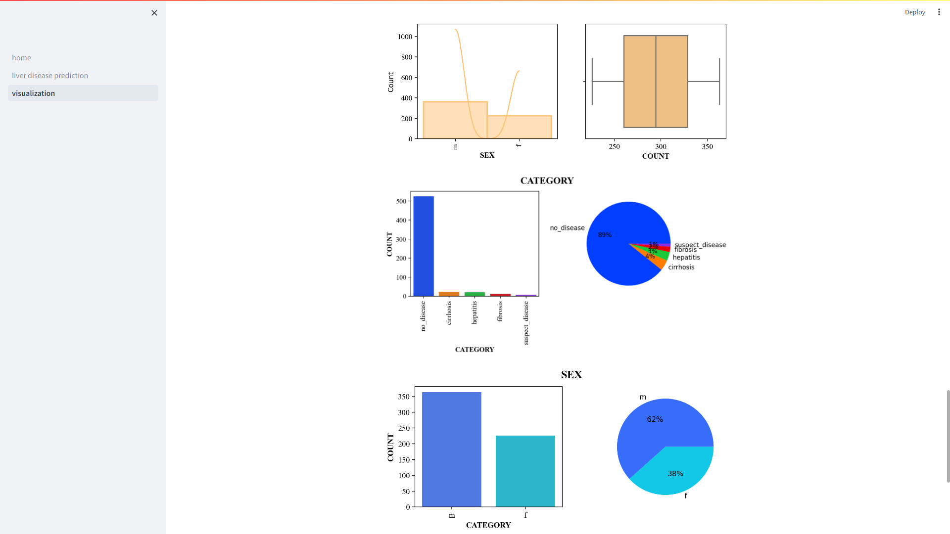
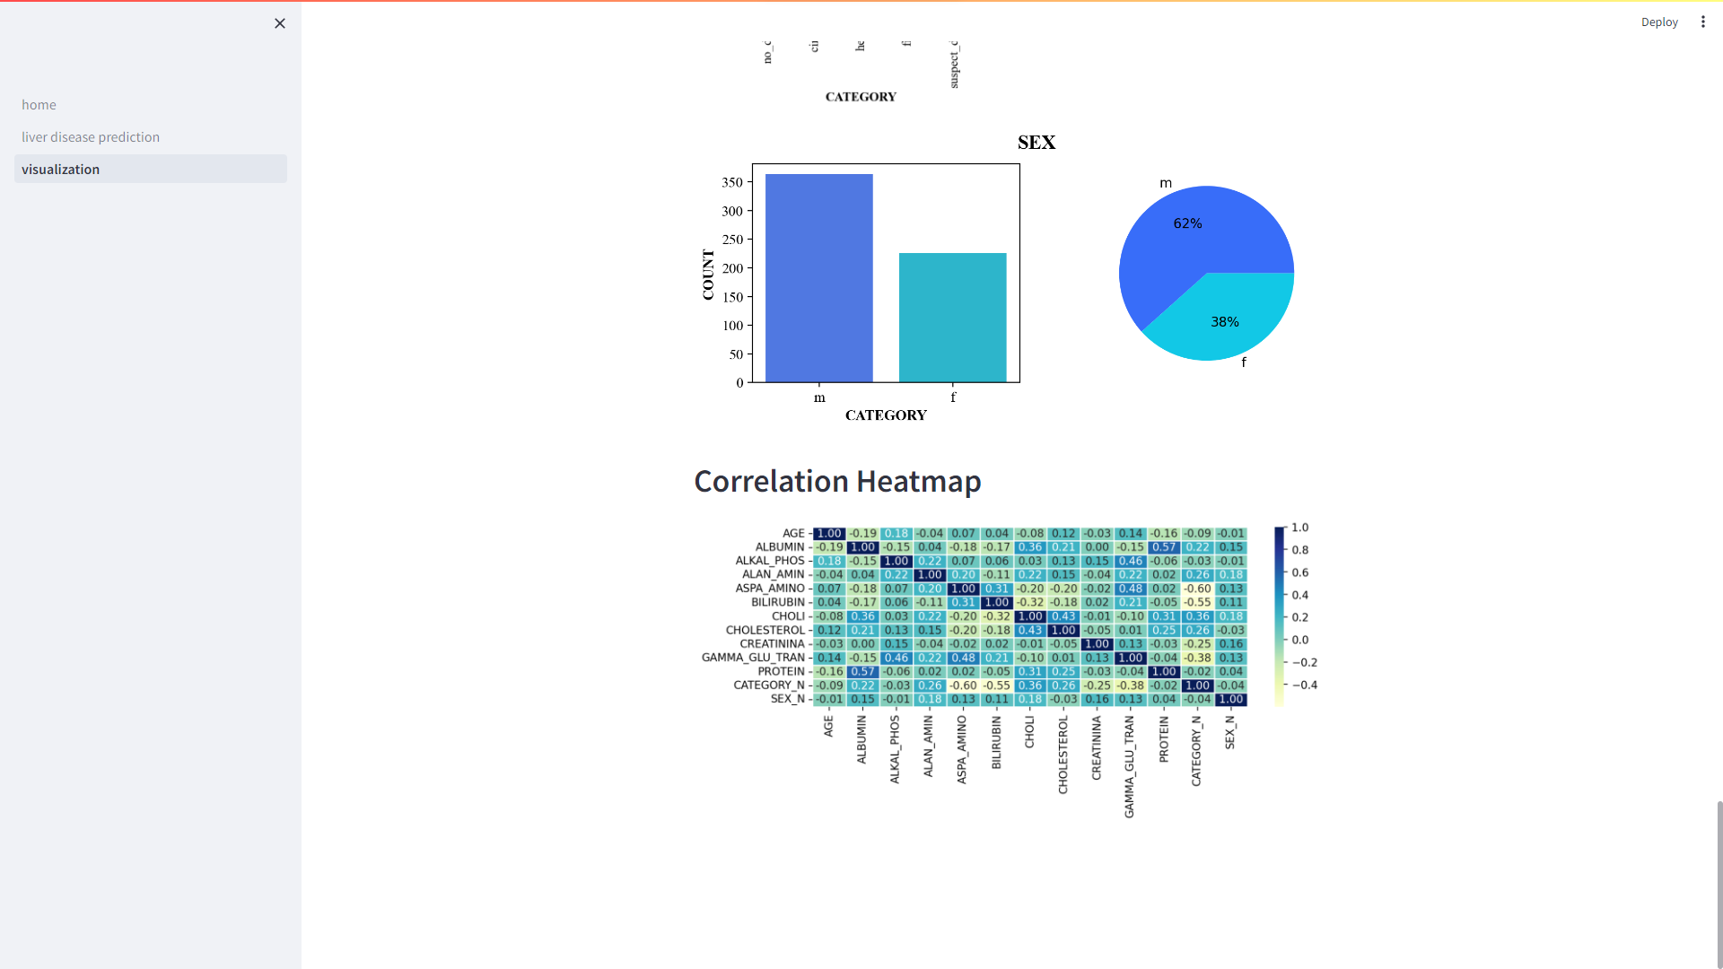
Visualisations

Slide 17
Displaying the Deployment

Slide 18
Thank you

